Slide 1
Unisys CloudForte™ Overview
Presented by: Peter O’Donoghue, Kevin Worley, and Lakshmi Ashok

Slide 2

Introduction

Slide 3
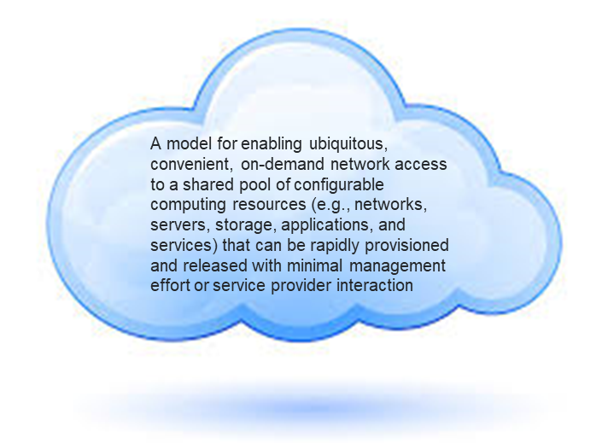
Cloud Computing¹ – A Definition
Five essential characteristics of a Cloud Service Provider (CSP)
On-demand self-service
Broad network access
Resource pooling
Rapid elasticity
Measured service
Three Service Models
Software as a Service (SaaS)
Platform as a Service (PaaS)
Infrastructure as a Service (IaaS)
Four Deployment Models
Public
Private
Community
Hybrid
1
NIST Special Publication 500-322
Evaluation of Cloud Computing Services Based on NIST SP 800-145 February 2018

Slide 4
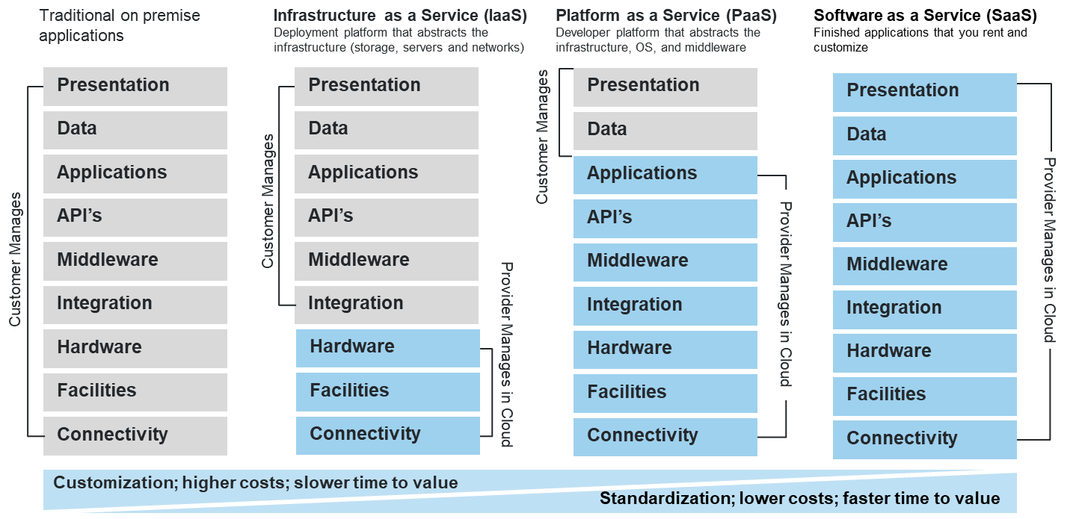
Cloud Service Models – A Definition

Slide 5
Cloud Service Providers – A Definition
Hyperscale Provider – Cloud Service Provider (CSP) of integrated IaaS+PaaS; Includes AWS, Azure and GCP²
Hyperscale Cloud MSP – Managed Service Provider that delivers services on Hyperscale CSP platforms²
Unisys CloudForteTM – Unisys’ multi-tiered AWS-optimized managed services platform that enables our clients to incorporate the benefits of a custom professional services engagement while yielding the economic and consistent benefits of a Hyperscale Cloud managed service
2
Gartner Magic Quadrant for Public Cloud Infrastructure
Managed Service Providers, Worldwide
29 March 2018

Slide 6
Challenges of Cloud Adoption
Lack of understanding of the public cloud “shared responsibility” model
Difficulties in making a migration business case
Lack of an actionable scalable migration playbook
A lack of skills to operate workloads in the public cloud
Concerns around data ownership and Security
Not fully understanding a FedRAMP package
Challenges in modernizing service management processes and tools to manage the public cloud
Paying for two environments simultaneously
Inflexible contracts
Providing a transparent invoice for cloud services that tie back to CLINS

Slide 7

Family
Enterprise Governance
Service Catalog
Financial Management
Monitoring Dashboards
CloudForte Cloud Management Platform
AWS Native Financial Governance
AWS Native Platform Management/Governance
AWS Migration Accelerators
Azure Native Financial Governance
Azure Native Platform/Management Governance
Azure Migration Accelerators
Private Cloud Native Platform Management/Governance
CloudForte for AWS
CloudForte for Azure
CloudForte for Private Cloud
Migration Acceleration
Business Case Development
Org Change Management
General Cloud CCoE
IT Service Management Process Renewal
CloudForte Adoption Accelerators

Slide 8
Family
Enterprise Governance
Service Catalog
Financial Management
Monitoring Dashboards
CloudForte Cloud Management Platform
AWS Native Financial Governance
AWS Native Platform Management/Governance
AWS Migration Accelerators
Azure Native Financial Governance
Azure Native Platform/Management Governance
Azure Migration Accelerators
Private Cloud Native Platform Management/Governance
CloudForte for AWS
CloudForte for Azure
CloudForte for Private Cloud
Migration Acceleration
Business Case Development
Org Change Management
General Cloud CCoE
IT Service Management Process Renewal
CloudForte Adoption Accelerators

Slide 9
Nuts & Bolts

Slide 10
Offering
A comprehensive managed services offering specifically designed for the management, governance, and migration of Amazon Web Services (AWS) public cloud environments.
Set of subscription services to securely manage and govern the use of AWS public cloud resources
Professional services that securely accelerates enterprise adoption of AWS cloud resources for agencies.
Envisioned and developed by seasoned Unisys cloud veterans to directly address the most critical challenges encountered by agencies at any stage in their journey to the cloud.

Slide 11
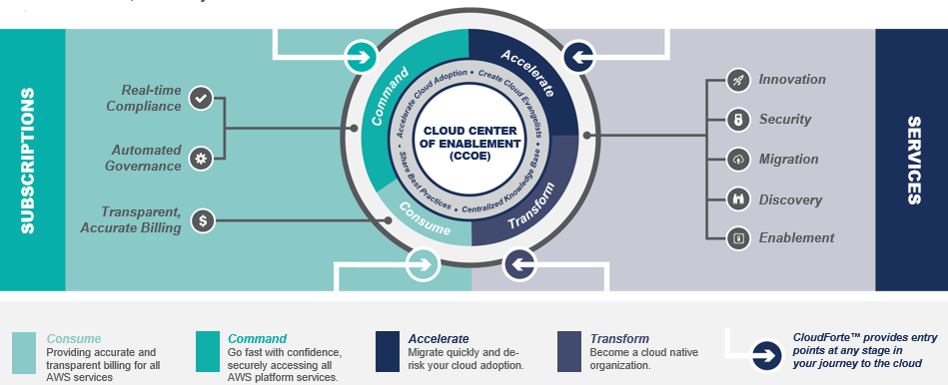
Services Snapshot
Includes both subscription-based platform services (Consume & Command) and expert professional services (Accelerate & Transform).
It is important to note that each service bundle contains features that enable individual consumption with no dependencies on other service bundles.

Slide 12
for AWS
DevOps
Account Setup
Financial
Management
Allows access to AWS catalog as it becomes GA in a governed compliant manner.
Solves financial oversight problems with AWS.
Accelerates AWS adoption.
Consume
CloudForte enables secure, governed access to native services
Service Catalog
Workload
Management
Backup/Restore
Log Aggregation
Cloud Native
Development Teams
Network,
Perf Monitoring
Security Monitoring
Command
Notification Service
Incident
Management
Asset Management
Change and Config
Management
Provides access to AWS cloud native services… with guardrails
Real Time Security
Compliance
Performance
Optimization
Accelerate
Migration
Accelerators
AWS Landing Zones
ATO
Accelerators
AWS Training/Certs
Transform
Org Change
Management/CCoE
Apps Modernization
Cloud Native
Applications
Data and Analytics

Slide 13
Consume & Command Services
Consume & Command subscription-based services include:
Fully compliant contract invoicing: Our fully- automated chargeback system takes all the guess work out of usage-to-Contract Line Item mapping.
Comprehensive metering and chargeback: Our financial management instrumentation covers all services offered by AWS on the day they are released for general availability.
Address ‘Shared Responsibility Model’: Scalable, cost effective and innovative security compliance services providing enterprise class management of AWS hosted workloads. Achieve ‘lights-out’ automation.
Access to cloud-native services with ‘guard-rails’: ‘Always on’ security policy engine ensuring workloads are always compliant. Discover and remediate drift in less than a minute.

Slide 14
Accelerate & Transform Services
Accelerate & Transform services include:
Enablement: Strategy, training, and organizational change management (OCM) services that helps Agencies successfully drive the mindset shift required by cloud adoption.
Discovery: Rapidly profile apps and workload portfolio and create a migration roadmap. Assemble a business case and identify adoption workstreams.
Migration: A repeatable approach to drive large scale migration to the AWS cloud that enables clients to measurably decrease time-to-market (TTM) and increase return-on-investment (ROI). Access AWS MAP discounts.
Security: Accelerates Authority of Operate (ATO) and provides compliance, advanced monitoring.
Process Renewal: Refactor your client’s management and governance processes to embrace ‘everything-as-code’ and public cloud. Bake DevSecOps into ITIL governance processes.
Modernization: Unisys is uniquely positioned to do the ‘hard yards’ of complicated application modernization

Slide 15
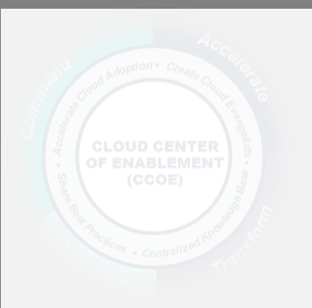
Cloud Center of Enablement (CCoE)
Catalyzing your transformation to a cloud-first organization
Educate and Engage in all aspects of your organization: Operations, Contracting, Security – Everyone Committed agents who are AWS certified and well-versed in your cloud objectives will actively engage and transform your organization.
Establish a community that creates, evangelizes, institutionalizes and shares best practices Cloud adoption is infectious. Give your cloud transformation a place to take root by establishing an open community to share institutional knowledge.
# 1 Cloud
Adoption Challenge
is a Skills Gap
Achieve Critical Mass to be
Self-Sustaining
Use our established knowledge base as your foundation.
BEST PRACTICES
DEMOS
SOURCE CODE
CCoE is about Education, Engagement, and Transformation
LESSONS LEARNED
EVENT INFORMATION
CLOUD FORMATION
TEMPLATES
USE CASES
REUSABLE ARTIFACTS
AMAZON MACHINE
IMAGES (AMI’S)
CCoE is the tip of the spear to accelerate cloud adoption by addressing culture, training, and skills challenges.

Slide 16
Selling CloudForte

Slide 17



Who Do We Target?
Enterprise CIO:
Traditionalists view public cloud as limitless compute, storage, and network.
ITIL
Avoid tech refreshes
Address disaster recovery needs
Manage surge demand
Mission CIO:
Mission CIOs driving digital transformation. Public cloud is a means to that end.
Digital Experiences
DevOps
Everything-As-Code
Automation
Lean Startup
CISO:
CISOs see uncharted waters, lots of risk, and loss of control.
Cloud sprawl/wild west
Not sure about FedRAMP
ATOs?
SOC integration
Cyber transparency and incident management

Slide 18
Talking to the Enterprise CIO
Challenge
Cloud adoption is hard.
Starting a Conversation
Status Quo
Status Quo
Why are folks struggling to adopt public cloud?
Apply private cloud playbook to adopting public cloud.
Have apps teams and infrastructure engineers move workloads.
Flaw
Flaw
How do you convince programs to adopt your cloud offering?
People aren’t ready. Don’t understand shared responsibility model. DC processes and tools will break.
Too slow. No systematic plan to attain an ATO. Not accessing cost savings of public cloud scale out architectures.
New Way
New Way
Initiate human capital transformation program. Embrace effective management and governance tooling.
Refactor/rehost with industrial scale tooling. Landing zones offers cost savings and acceleration of ATO.
Likely Outcome
Likely Outcome
Transformed workforce. Lower cost and effective tooling and processes.
Reduce time-to-market. Save cost. Glidepath to an ATO for GSS and Apps.

Slide 19
Talking to the Mission CIO
Challenge
Must deliver digital transformation faster!
Starting a Conversation
Status Quo
How well are you managing your cloud financials?
We’re doing DevOps on the cloud. It’s awesome!
Flaw
Flaw
How much insight do you have into those instant probes you get from China and Russia?
Limited enterprise IT Ops. Poor financial management. Cloud sprawlooza!
Cyber security has taken a back seat to speed and everything-as-code.
New Way
New Way
How are you dealing with cloud sprawl?
Overlay a lightweight, scalable and enterprise class approach to enterprise IT Ops.
Cloud native cyber operational tooling and incident management. Continuous compliance.
Likely Outcome
Likely Outcome
Apply financial oversight. Provide transparent high quality services.
Get compliant. Stay compliant. See attacks and respond.

Slide 20
Talking to the CISO
Challenge
Comply with NIST 800-53 while adopting cloud
Starting a Conversation
Status Quo
Status Quo
How comfortable are you with FedRAMP packages?
Applying legacy approach of authorizing workloads. Checking out FedRAMP packages.
Apply data center perimeter security strategies to protect public cloud hosted workloads.
Flaw
Flaw
How much insight do you have into those instant probes you get from China and Russia?
ATOs are not getting done. Entire cloud migration initiative stopped dead.
Struggling to protect or enforce comprehensive security policies in public cloud.
New Way
New Way
You able to keep up with demand for authorizing migrating workloads?
Inherit FedRAMP package. Automate ATO process as much as possible.
Security in depth. DevSecOps. Plug cyber gaps in shared responsibility model. Continuous compliance.
Likely Outcome
Likely Outcome
How to de-risk cloud adoption?
Port ATOs with your workloads to public cloud.
Cyber transparency. Effective cyber incident management. Secure workloads.

Slide 21
The Landscape

Slide 22
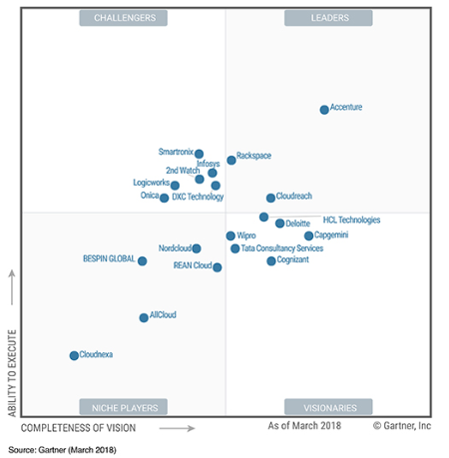
Federal Market Competitors
Gartner's Magic Quadrant for Public Cloud Infrastructure Managed Services Providers
Competitor | AWS Managed Services
Accenture | Audited Since: 2016 FedRAMP: Moderate
Rackspace | Audited Since: 2015 FedRAMP: Moderate
Deloitte | Audited Since: 2017 FedRAMP: Moderate
Smartronix | Audited Since: 2015 FedRAMP: None
REAN Cloud | Audited Since: 2015 FedRAMP: In-process Low

Slide 23
Competitor Go-To-Market
Proprietary Tooling | AWS-Audited Competencies | Pricing / Acquisition
Customer Obsession | + Advisory Services | Thought Leadership
Competitor | Core Strengths
Accenture |  | Heavy focus on Migration & Transformation services Multi-cloud provider
Rackspace |  | Evolved from traditional hosting provider Multi-cloud provider
Deloitte |  | Introduced Value-based pricing Entered market through acquisition
Smartronix |  | Wide breadth of contract vehicles available Focus on automation and platform services
REAN Cloud |  | All-in AWS Heavy DevOps orientation

Slide 24
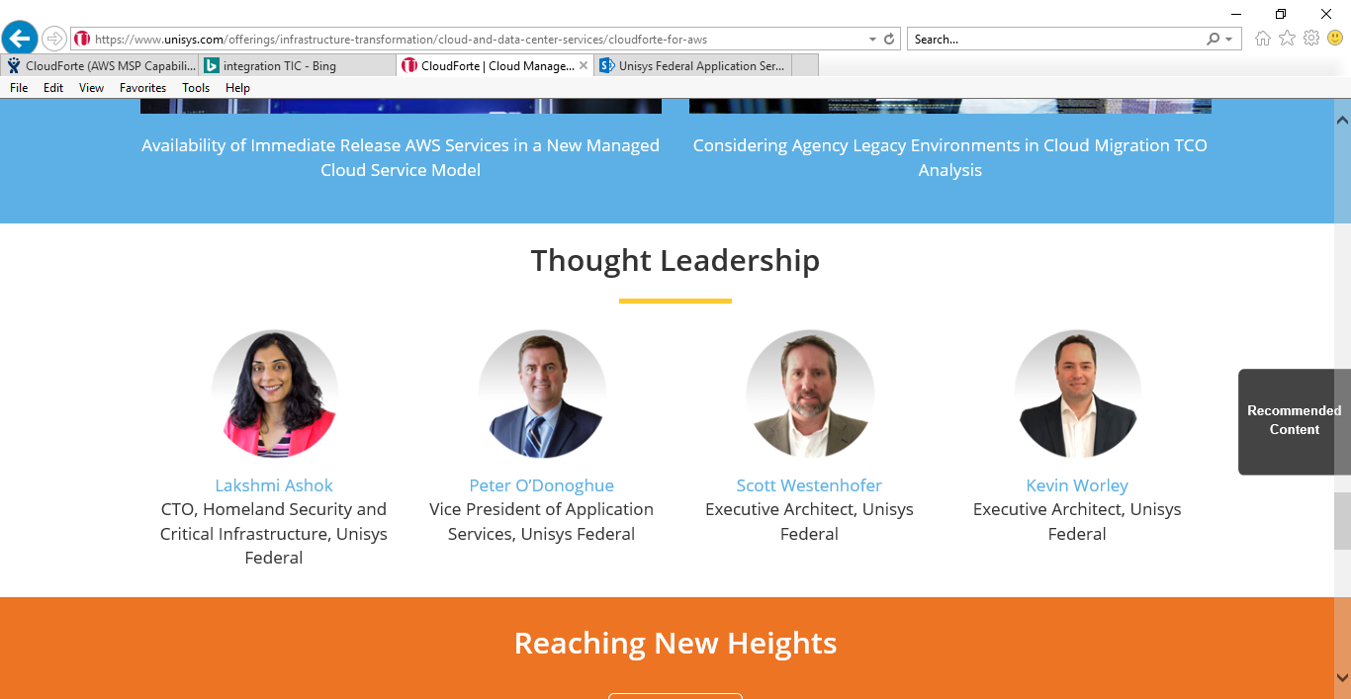
Resources
CloudForte™ Microsite
Contains our approved value proposition and pitch, an Executive Brief, White Papers, videos, and blogs.
Federal Application Services SharePoint site
Contains a working body of CloudForte™ content currently in development.

Slide 25
Unpacking CloudForte

Slide 26
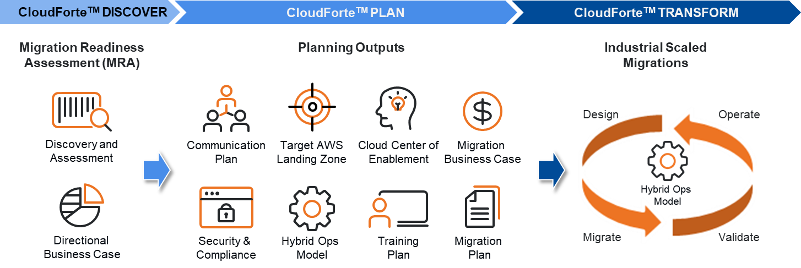
Migration Accelerator
Industrial scale migration
Frameworks and Enablers:
The Migration Readiness Assessment (MRA) helps assess organizational cloud migration capabilities, readiness, and commitment.
The CloudForteTM Migration Accelerator provides a proven comprehensive business-driven methodology and associated toolkit to accelerate the cloud migration journey.
Our Migration Accelerator approach provides structure to identify and address gaps in skills and processes, and produces an actionable plan to guide the cloud adoption journey.
The AWS Well Architected Framework (WAF) is used to assess and optimize applications and workloads to take advantage of AWS native features of resilience, scalability and cost efficiency while also assuring a continuous cyber security posture.
Best Practices:
Prioritize legacy IT assets to migrate to enable customers to measurably decrease time-to-market and increase return-on-investment as quickly as possible.
Leverage the Unisys dedicated Cloud Center of Enablement (CCoE), community of 300+ certified cloud Subject Matter Experts and established partnership with AWS to enable the continuous improvement of cloud foundations, applications and operations.
Develop migration approach and plan that addresses not only the applications to be migrated, but also the impact to the business (people, process, policies & procedures).
Define Landing Zones to provide foundation for accelerated application migrations.
Notes:
[EXECUTING MIGRATION JOURNEY]: So how is the migration journey executed and accelerated?
Following the MRA, the initial planning focus is on Portfolio Discovery and Planning, Business Case development and Workload Evaluation and Selection
This planning forms the basis for the initial or first wave of execution during the MRA – which includes creating a Migration Plan, Landing Zone, App Design/Migration/Validation, and operation of the migrated applications
Continual migrations wave follow, each building upon the experience of the previous wave.
Throughout this process cloud expertise is built as an Operation Model, Security & Compliance and Center of Excellence are developed over time. An agile process is used with sprints focused on developing the cloud expertise and operation polices & procedures to successfully migrate and operate each wave of targeted workloads.
Throughout all this, the Migration Resource Toolkit provides best practices, experiences, artifacts, migration patterns all developed through the experience of migrating over 100 enterprise customers.
After many waves of migration and sprints to build cloud expertise, your cloud operating model evolves and matures to successfully manage and operate your migrated applications

Slide 27

Consume
Accurate and transparent billing for all AWS services
The Unisys Difference
Fully compliant Federal contract invoicing
Commercial tools don’t meet the unique requirements of Federal contracts. Our fully- automated chargeback system takes all the guess work out of usage-to-CLIN mapping.
Comprehensive metering and chargeback
Our financial management instrumentation covers all services offered by AWS on the day they are released for general availability.
Account Setup
Billing, Cost Metering,
& Invoicing

Slide 28
Command
Go fast with confidence, securely accessing all AWS cloud-native services
Automated Governance
The Unisys Difference
Access to new cloud-native services on the day they are released by AWS Enable your team to move with speed an agility to solve mission problems without compromising on enforcement of governance and security policy compliance.
Focus on Operational Integration
Migration is about more than workloads. Your investment in ITIL and other IT operational frameworks can be economically leveraged into an effective DevSecOps-based model. Our approach is as much about people and process as it is technology.
Environment
Service Catalog
Cloud-native
Backup and Recovery
Log Aggregation
Real-time Compliance
Network, Security, & accelerated ATO
Performance
Notification Services
AWS Experts
Performance & Financial Optimization
Technical Account Manager (TAM)
Service Desk
Incident, Asset, & Configuration Management
Cloud Center of Enablement

Slide 29






Acceleration Services
Migrate quickly and de-risk your cloud adoption
The Unisys Difference
Comprehensive services from a proven cloud pioneer Cloud adoption requires a steady and experienced hand. Unisys brings large scale migration and modernization experience—with hundreds of AWS certified professionals—to bear to minimize your risk.
A practical approach to migration
We use an industrial scale approach to identify and prioritize legacy IT assets to migrate, enabling customers to measurably increase return-on-investment as quickly as possible.
Enablement
Migration
Attain the right skills
AWS Training/Certification Program
Multiple Treatments for Moving Workloads to the Cloud
Lift-and-Shift Application Migration
Data Migration Services
Refactoring to harness cloud advantages
Landing zones
Migration Readiness
Assessments and Planning
Portfolio Assessments
Business Case Development
Migration Plans
Managed DevSecOps pipelines
Process Innovation
Reengineer ITIL, management and governance processes to integrate cloud services
Asset management, incident management, event management
Security
Accelerated ATO
Accelerate planning, engineering, designing, certifying and attainment of security accreditation
Integrate with cloud management platforms

Slide 30

Transformation Services
Become a cloud native organization
The Unisys Difference
Industrial grade modernization of legacy applications Rid your organization of costly and predatory enterprise license agreements by tackling the hard migrations with our advanced Migration services.
Security-first mindset
If you’re not already thinking about getting and keeping an ATO in the cloud, you need to start now. We’ve been down this path before and will help you accelerate your ATO process.
Security
Enablement
Accelerated ATO
Application Accreditation/ATO
Cyber/Biometric Identity Services
Making the Culture Shift to Cloud
Enterprise Cloud Strategy
Organizational Change Mgmt.
- Strategic & Tactical Comms
- Training & Enablement
- Governance
New AWS Service Injection/Strategy
AWS Operational Integration
AWS Native Services Pilot
Innovation
Optimize for Cloud Native
Serverless Architecture
Microservices Architecture
Cloud Native Development
Big Data / Data Analytics
High Performance Computing
Advanced Operational Services
Migration
Multiple Treatments for Moving Workloads to the Cloud
White Glove Application Migration
- COBOL Rebuild
- zOS/Solaris/AIX/Unix Replatform
- Oracle Legacy to AWS
Discovery
Baseline for Optimization
High Availability Baseline
Enterprise Scale Performance Baseline
Advanced Monitoring Service

Slide 31

www.unisys.com/inteliserve

